Slide 1
Ways to study ethics
When values compete

Slide 2
When values compete
Four fundamental values:
Freedom;
Equality;
Justice;
Respect for privacy and autonomy.
These values conflict. In the old “Star Trek” television series, the “prime directive” required no interference in other cultures. [http://www.youtube.com/watch?v=4mH-L6UCCAE]
But what if another culture’s values so conflict with our own that we conclude they are evil? Is this why we fought against the Taliban? Against Saddam Hussein? Against Hitler?

Slide 3
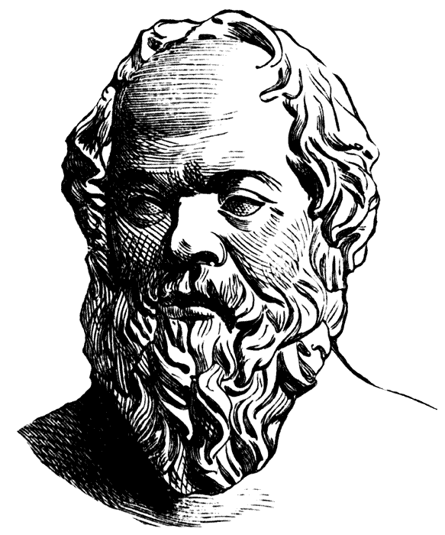
When values compete
Socrates considered Such ethical values more than two thousand years ago.
What is good?
What is just?
He said to behave ethically would inevitably lead to conflicts.

Slide 4
When values compete
Philosophers after Socrates divided ethics study into three areas:
Metaethics.
Normative ethics.
Applied ethics.

Slide 5
When values compete
Often coming up with the right answer is difficult because values conflict.
Our values govern our attitude.
Examples:
Individual privacy vs. right to know what officials are doing.
Sanctity of life (anti-abortion) vs. individual autonomy (pro-abortion).

Slide 6
When values compete
Attitudes, based on values, have three components:
Affective;
Cognitive;
Behavioral.

Slide 7
When values compete
Where do we get values and attitudes? Everywhere: parents, religion, friends, co-workers, the media.
The famous “Heinz Dilemma” indicates how they can conflict.

Slide 8
When values compete
These conflicts happen often in our own lives.
How about an instructor’s grade dilemma?

Slide 9
When values compete
What about you?
Consider a value you hold: equality, justice, respect for privacy, do not lie, kindness, etc.
Where do you think your value came from? Parents, teachers, religion, media?
How do your attitudes reflect your value, affective, cognitive and behavioral?
Have you ever had difficulty with your value conflicting with others?

